Slide 1
Google Earth Web
GskyGE_GEOGLAM
A web app to use Google Earth Web with GEOGLAM
Creates KMLs for Google Earth Web (GEWeb) to simulate GSKY Web Map Service.
This app is by far the only way to display GSKY Web Map Service in both spatial and temporal dimensions outside of TerriaMap.
Copyright © 2019 by National Computational Infrastructure, Canberra, ACT, Australia.
Author: Dr. Arapaut V. Sivaprasad.
Created: 02 April, 2019

Slide 2
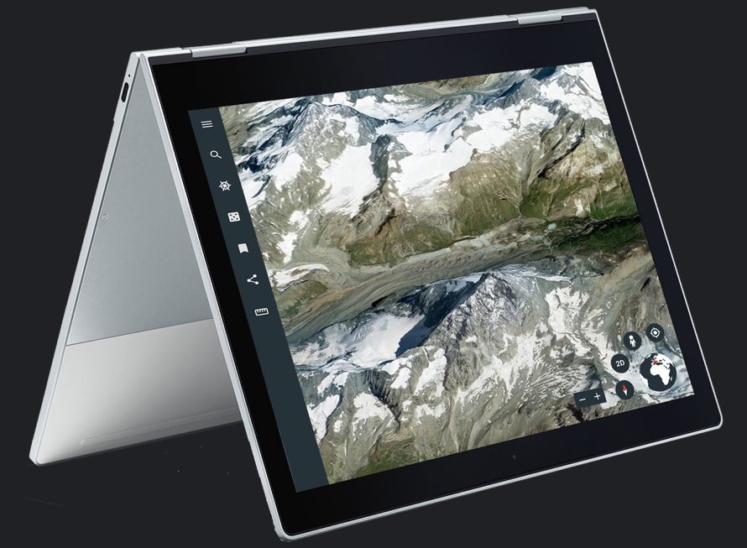
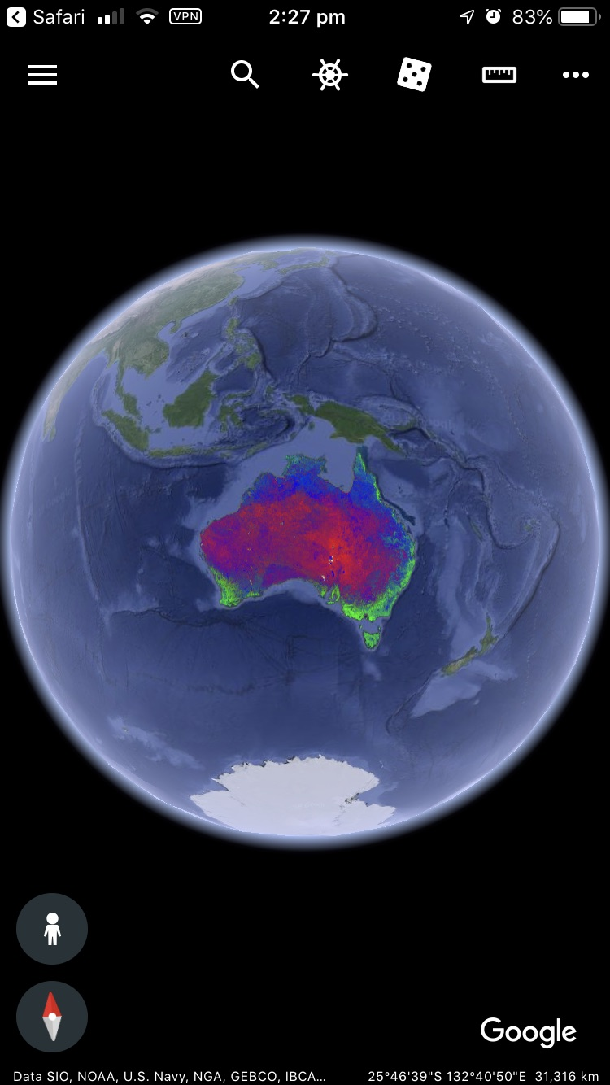
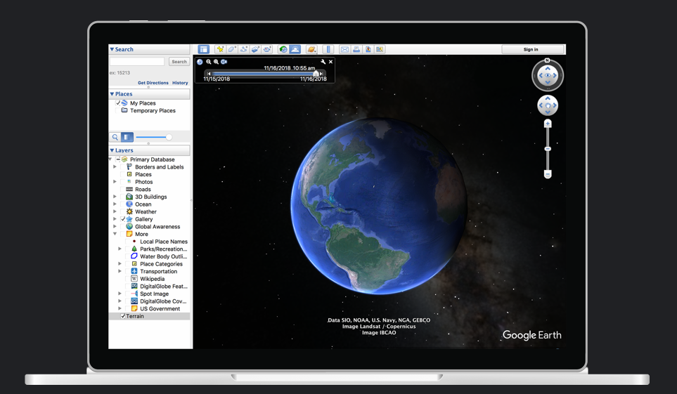
INTRODUCTION
Slides 2-6 are for developers. Slides 7 -14 form the user guide.
Google Earth Web (“GEWeb”) is a web-based version of the Google Earth Pro desktop (“GE”). While it has many new features, it lacks some that are in GE. Of these, the main missing item is a WMS facility. Unlike GE which can take a WMS server URL (e.g. GSKY server) and display the layers, GEWeb lacks this feature. It uses a KML (Keyhole Markup Language) to display static images. This facility is experimental and was included so that users could import the maps saved in GE.
The primary advantage of using GEWeb over GE is that it is platform independent. But it is browser-dependent and currently works only in Google Chrome. There is a mobile app as well.
Google Earth Mobile
Google Earth Web
To GSKY it offers another advantage as well. While WMS is possible in GE, there is no way to display time-based layers. The “GetMap” request sent by GE does not carry the “TIME=“ parameter. There is no way, as yet, to add this by us. Hence, only the latest time slice can be shown.
With GEWeb one can display a layer using KML which can take a ‘TIME=‘ parameter. To generate the KML one must know the Lat/Lon coordinates of the region and the layer name. A call to the GSKY server can be made as follows. It will display a static image corresponding to the GSKY layer and coordinates.
http://130.56.242.15/ows/ge?SERVICE=WMS&amp;VERSION=1.1.1&amp;REQUEST=GetMap&amp;SRS=EPSG:4326&amp;WIDTH=512&amp;HEIGHT=512&amp;LAYERS=global:c6:total_cover&amp;STYLES=default&amp;TRANSPARENT=TRUE&amp;FORMAT=image/png&amp;BBOX=112.324219,-44.087585,153.984375,-10.919618&amp;TIME=2001-01-01T00:00:00.000Z
Google Earth Desktop
This tutorial is about GEWeb for GEOGLAM and describes its use on Chrome and mobiles.
NOTE: Unlike in a WMS service as in TerriaMap, ArcGIS or even GE, zooming in/out or panning the map will not change the image to cover more regions. It will continue to show the same image resized to suit.
Next: Technical Details

Slide 3
Technical Details
KML Syntax:
A minimal KML file to show a layer will have the following:
Headers:
<?xml version="1.0" encoding="UTF-8"?>
<kml xmlns="http://www.opengis.net/kml/2.2" xmlns:gx="http://www.google.com/kml/ext/2.2"
xmlns:kml="http://www.opengis.net/kml/2.2" xmlns:atom="http://www.w3.org/2005/Atom">
Body:
<Document>…</Document>
Item container:
<GroundOverlay>…</GroundOverlay>
Title:
<name>Total Cover C6 </name>
Visibility setting:
<visibility>1</visibility>
Image Spec:
<Icon>… </Icon>
GetMAP request
<href>…</href>
Coordinates:
<LatLonBox>…<LatLonBox>
End:
</kml>
Example KML:
<?xml version="1.0" encoding="UTF-8"?>
<kml xmlns="http://www.opengis.net/kml/2.2" xmlns:gx="http://www.google.com/kml/ext/2.2" xmlns:kml="http://www.opengis.net/kml/2.2" xmlns:atom="http://www.w3.org/2005/Atom">
<Document>
<GroundOverlay>
<name>Total Cover C6 </name>
<visibility>1</visibility>
<Icon>
<href> http://130.56.242.15/ows/ge?SERVICE=WMS&amp;VERSION=1.1.1&amp;REQUEST=GetMap&amp;SRS=EPSG:4326&amp;WIDTH=512&amp;HEIGHT=512&amp;LAYERS=global:c6:total_cover&amp;STYLES=default&amp;TRANSPARENT=TRUE&amp;FORMAT=image/png&amp;BBOX=112.324219,-44.087585,153.984375,-10.919618&amp;
</href>
</Icon>
<LatLonBox>
<north>-10.919618</north>
<south>-44.087585</south>
<east>153.984375</east>
<west>112.324219</west>
</LatLonBox>
</GroundOverlay>
</Document>
</kml>
NOTE: Google Earth uses the WMS specification 1.1.1. Sending the request in 1.3.0, which is what GSKY has implemented, will result in error. To solve this, the GSKY server code has been changed to send the GetCapabilities response in v1.1.1. The production version at https://gsky.nci.org.au/ows/ will not work, as it still sends in v1.3.0.
By using KML we can circumvent this limitation and the production GSKY end point can be used.
Next: Steps to Build the Web App

Slide 4

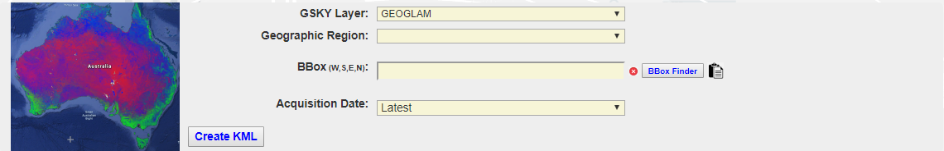
Steps to Build the Web App
http://130.56.242.19/geoglam.html
STEPS
Customise a front page.
Insert a web form using Ajax/CGI.
Generate the KML, based on user input.
Download and save the KML file.
Open the KML in Google Earth Web or Mobile.
Generating the KML:
Javascript and Ajax based form.
Selecting a GSKY layer gets its available dates of acquisition.
These are hard coded in a JS file.
Selecting a geographical region gets its Lat/Lon coordinates.
These are hard coded within the HTML form.
Can select one or more dates.
Can change the Lat/Lon coordinates of a bounding box.
Use the inbuilt “BBox Finder” to find the values for any area.
The form input values are sent to a CGI on a webserver.
The CGI generates a KML file and store it as *.kml on the server.
A clickable link is sent back to the page to be displayed.
User clicks this link to download the KML file.
This KML is opened in GE Web and GE Mobile.
Code:
HTML and JavaScript.
See the GitHub repo.
ajax.js
AJAX functions to send and receive from CGI.
Data acquisition times for the GSKY layers.
CGI:
See the GitHub repo.
NOTES
A few geographical regions are hard coded in the page. This includes Australia as a whole and each state separately, USA and three sections (West, Center and East), NZ and Europe. The user can specify any other region by finding its Lat/Lon values.
If using a larger region (e.g. whole of N. America) the GSKY server will send a “Zoom in to View” message instead of the layers. Unlike in a WMS service, zooming in will not display anything other than the same message.
Displaying on Google Earth Web:
My Places | Import KML File
Displaying on Google Earth Mobile:
Click “Open in Google Earth”
Next: Publish the Web App

Slide 5
Publish the Web App
If there is a webserver listening on port 80 or 443 it is a simple matter of cloning the following GitHub repo into a suitable directory under your HTML root. See the previous slide to know how to create/edit the web App.
Github Repo:
https://github.com/asivapra/gsky/tree/master/GSKY_Clients/GoogleEarth/WebGoogleEarth
The Web App can be tested at: http://130.56.242.19/geoglam.html
If there is no publicly facing webserver on the Linux machine, you can start a minimal webserver using Python as below.
For Python 2.x:
python -m SimpleHTTPServer&
For Python 3.x:
python -m http.server
In both cases the webserver will listen on port 8000. Unless this port is open to the world you will have to create an SSH tunnel to access the page. See slide 9 in GSKY-Thredds_Integration.pptx to learn about SSH tunneling.
While the http server is running and the SSH tunnel is open, you can view the web app by the URL: http://localhost:8000/WebGoogleEarth/geoglam.html
Next: Hints and Tips

Slide 6
Hints and Tips
NOTES
The GSKY version that is compatible with GE and GEWeb resides on a VM behind the NCI firewall. It will work only if you have a VPN connection to the NCI network.
GEWeb is NOT a WMS-enabled client like TerriaMap, ArcGIs, Google Earth Desktop, etc. We explained how to use its KML-based display of images to show GSKY layers.
There is no difference in the data being fetched, except that it is static. You cannot pan or zoom to see more data. Instead, GEWeb will call GSKY server for the same data.
While the above limitation makes it slightly more cumbersome to use, zooming and panning can be done indirectly by supplying the Lat/Lon coordinates.
The picture quality of the globe and the GSKY layers are better than on all other clients. Google’s gimmicks in rotation of the globe, display of clouds, etc. are aesthetically pleasing too.
Google Earth Mobile is by far the only mobile app that can display GSKY layers, if you have a VPN connection on the mobile.
TIPS
Always save the layer after you add a KML file. It will stay across browser sessions.
Select multiple time slices if you wish to explore. Each time slice will become a separate layer.
Too many layers open at the same time may result in a crash of the app. This is due to the high RAM usage by Chrome.
Next: User Guide

Slide 7
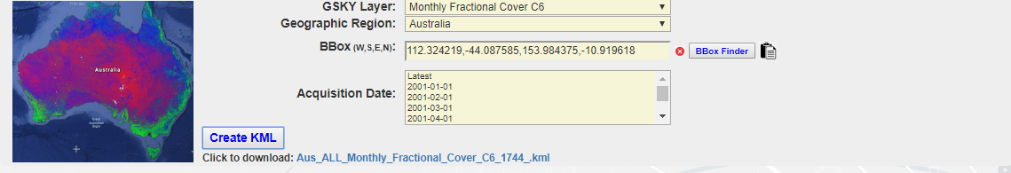
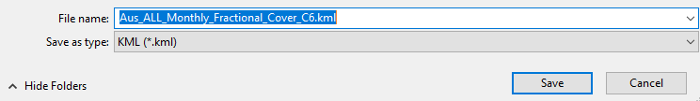
User Guide
This slide must be viewed as a slide show to see all elements.
Create the KML
http://130.56.242.19/geoglam.html
Next: Display in Google Earth Web

Slide 8
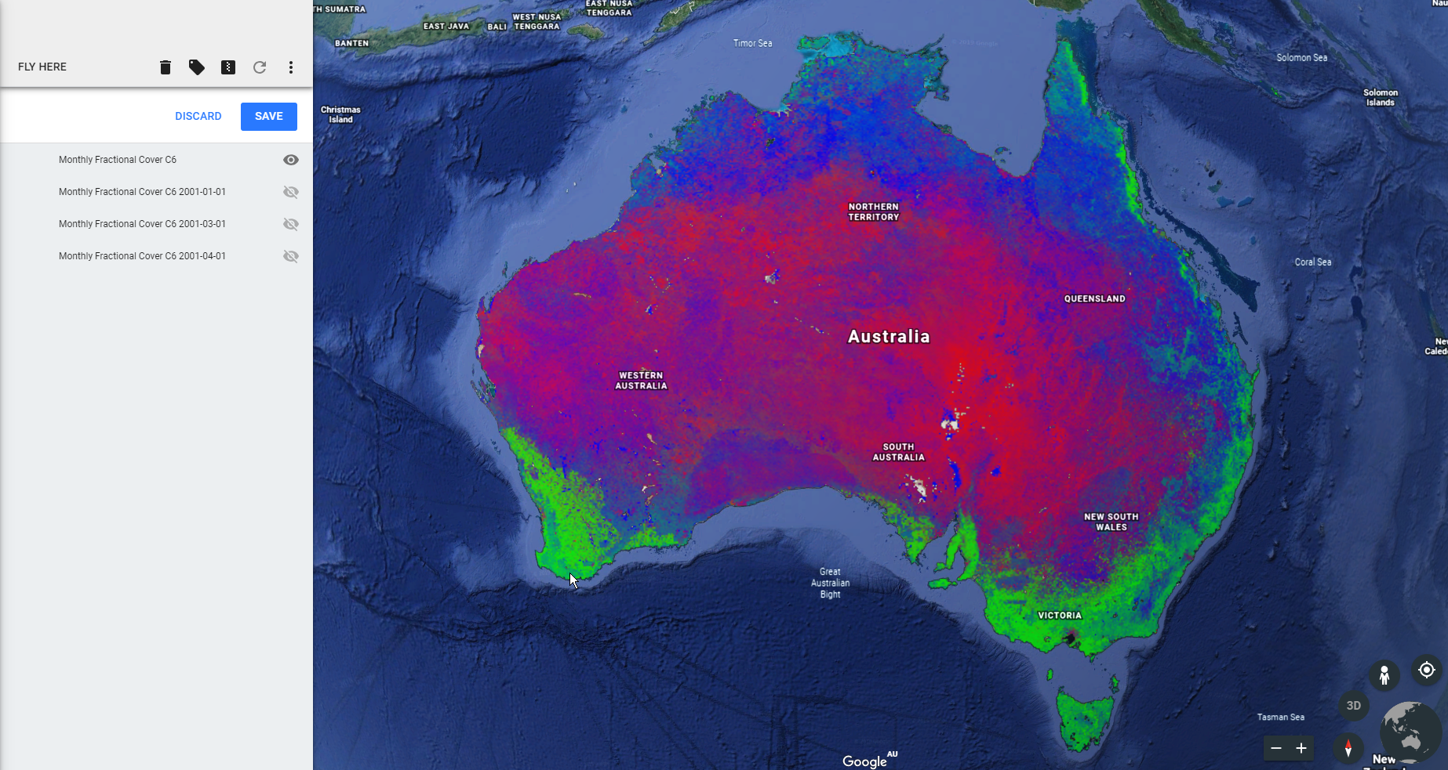
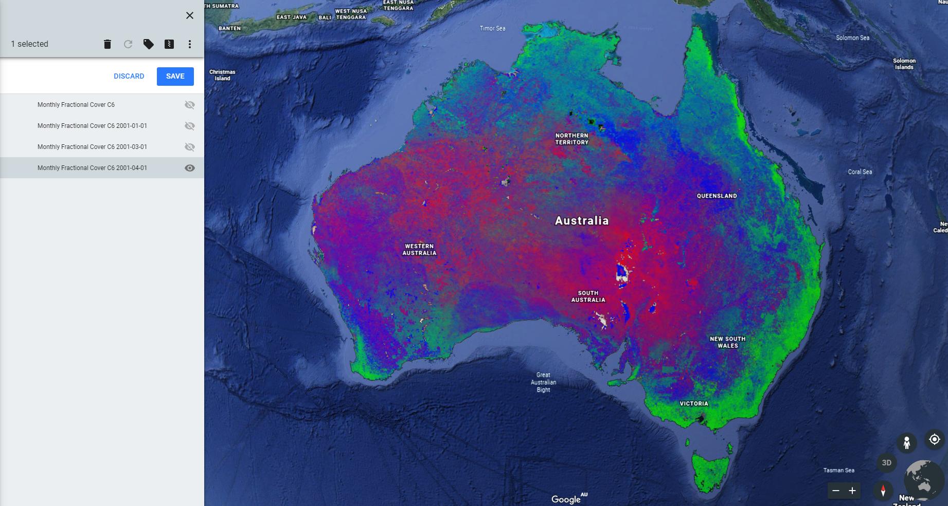
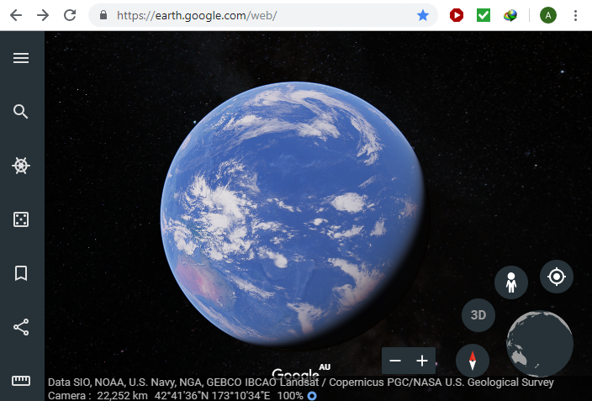
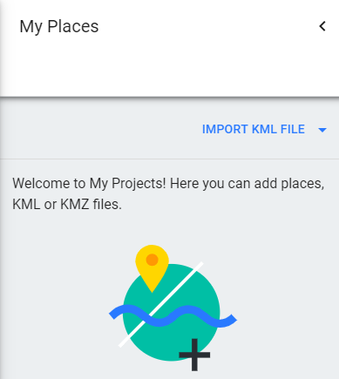
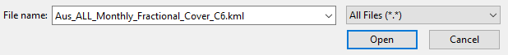
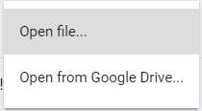
User Guide
Display in Google Earth Web
Google Earth Web: https://earth.google.com/web/
NOTE: The Google Earth Web’s GUI has changed since creating this tutorial. The buttons and controls are slightly different but are still intuitive to use. It is recommended that this slide is recreated with the current, or future, changes in the GUI.
Next: Other Regions

Slide 9
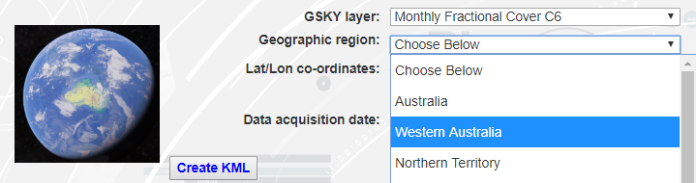
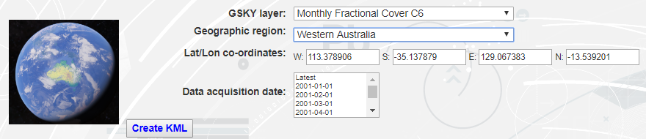
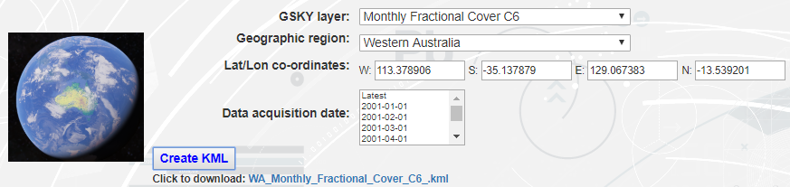
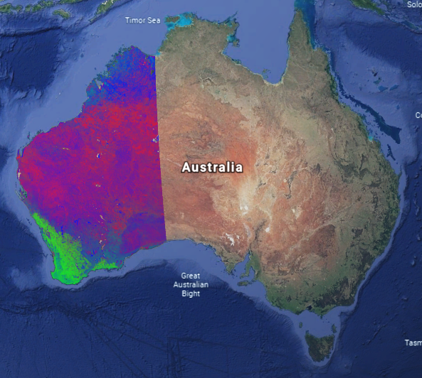
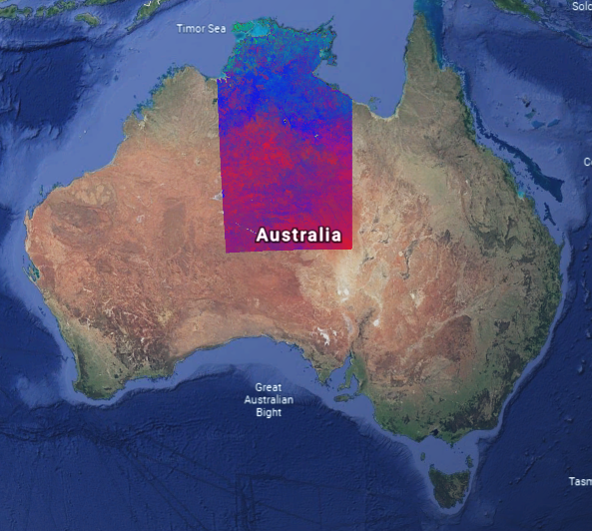
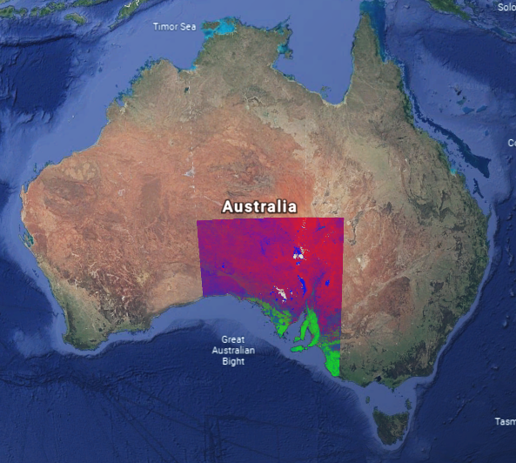
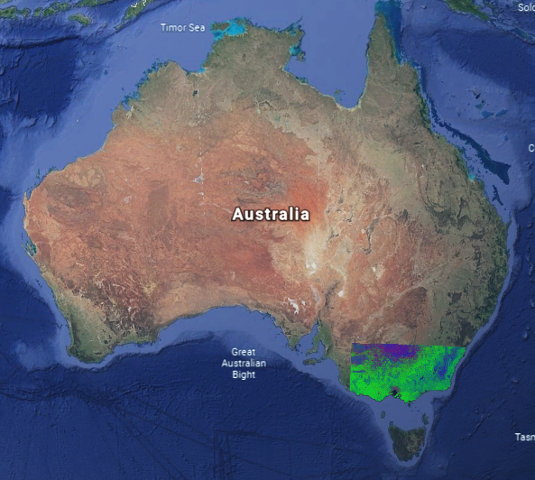
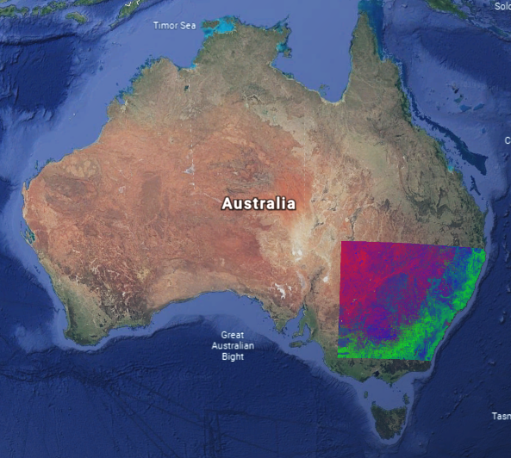
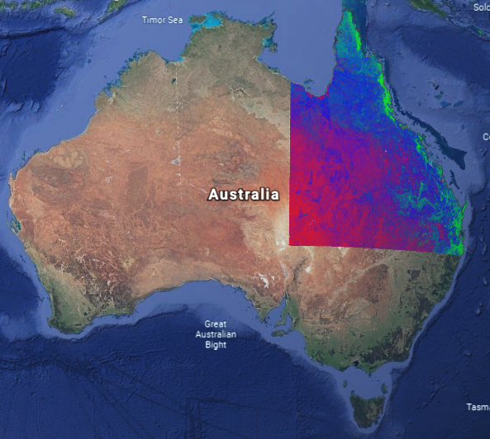
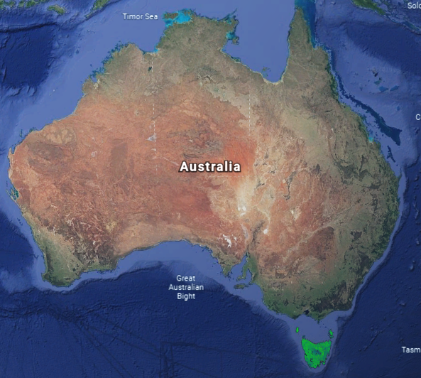
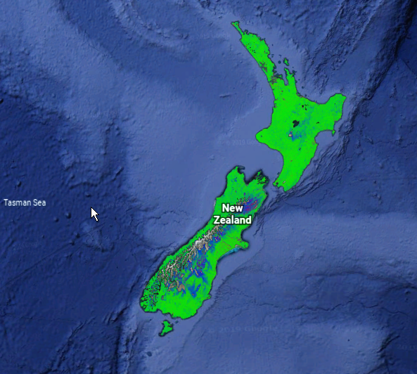
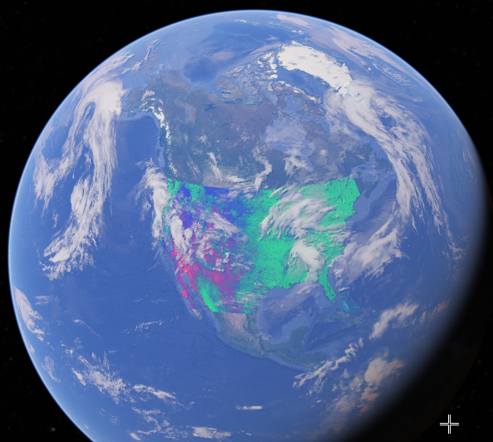
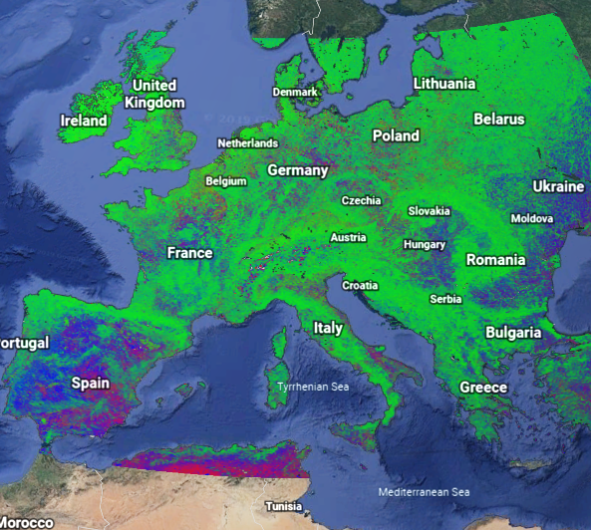
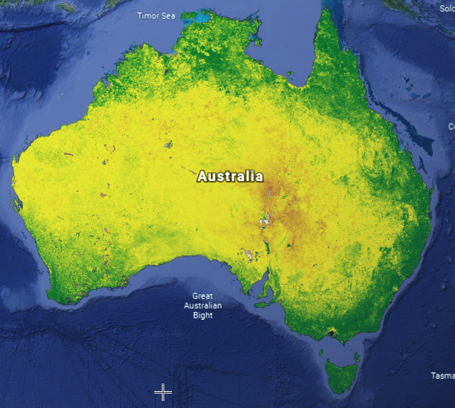
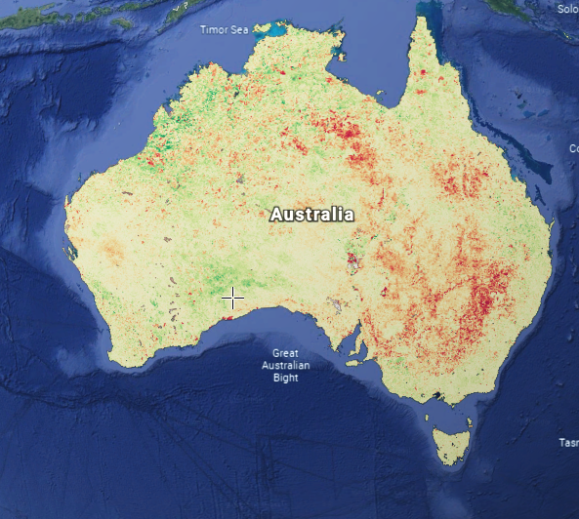
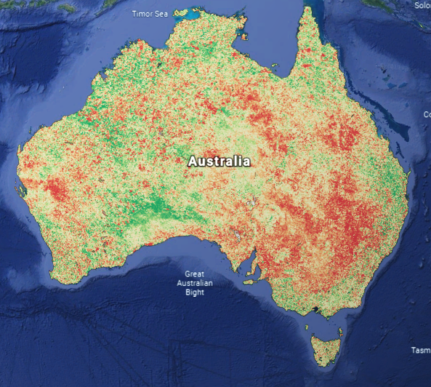
User Guide
Display in Google Earth Web
Google Earth Web: https://earth.google.com/web/
Next: Custom Coordinates

Slide 10
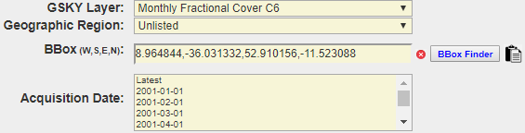
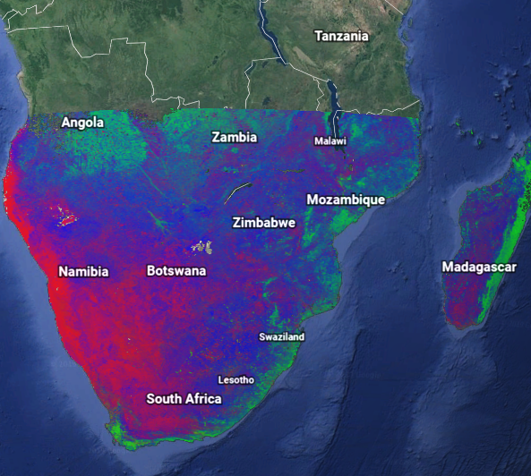
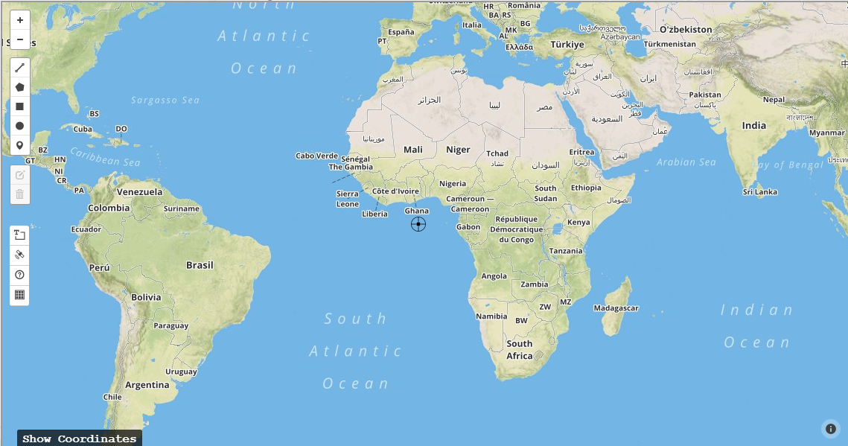
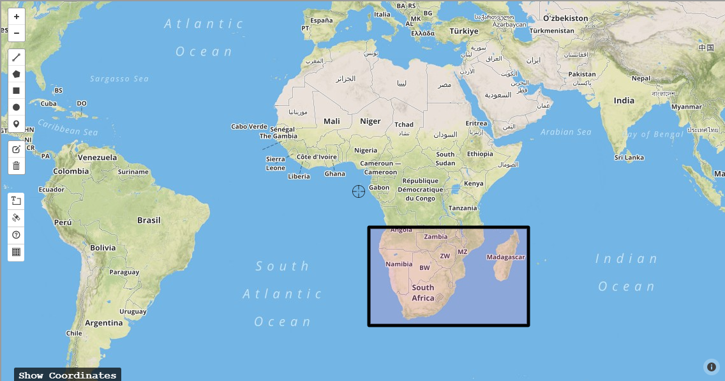
User Guide
Get Bounding Box using BBox Finder
To display the GSKY layers over a region not listed, you can find its Lat/Lon coordinates using an inbuilt “Bbox Finder”.
Next: Google Earth Mobile

Slide 11
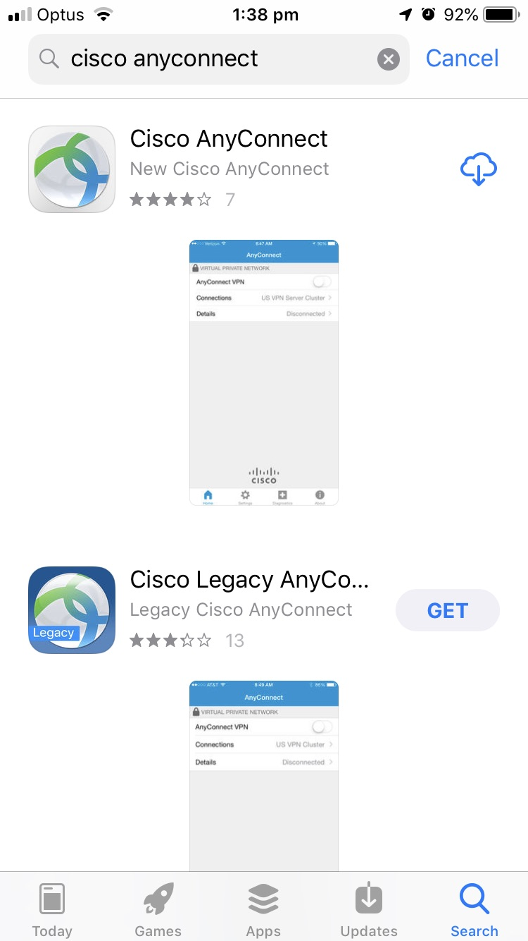
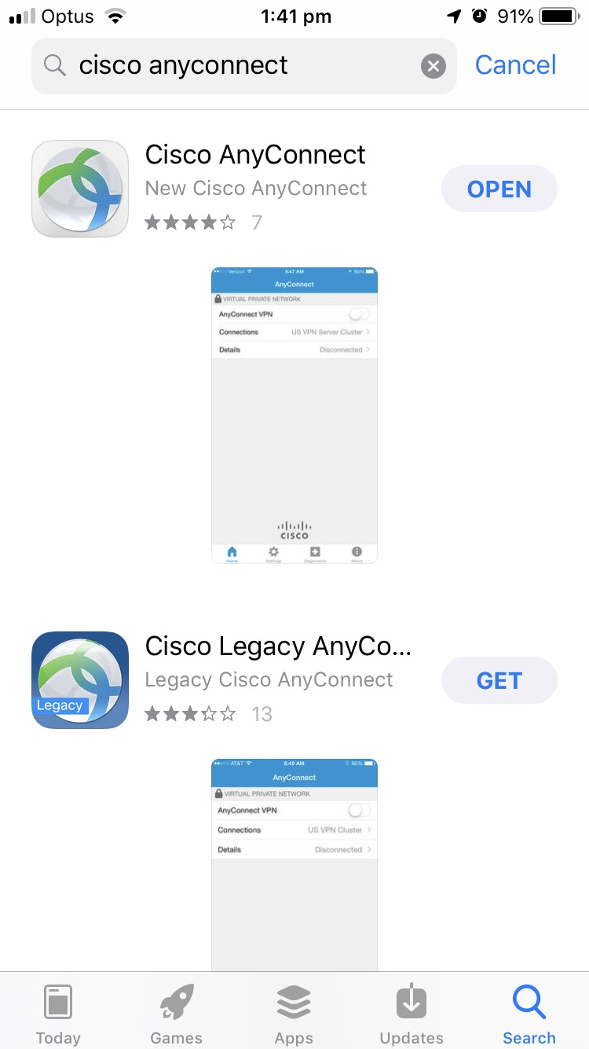
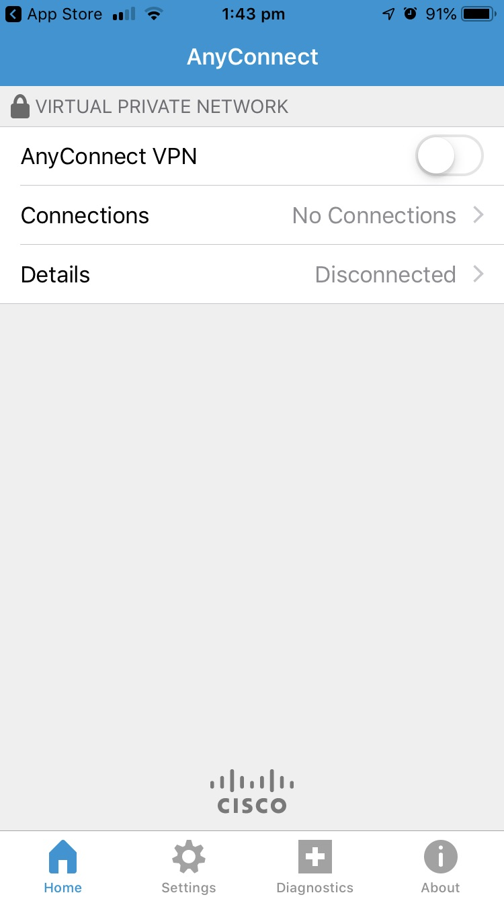
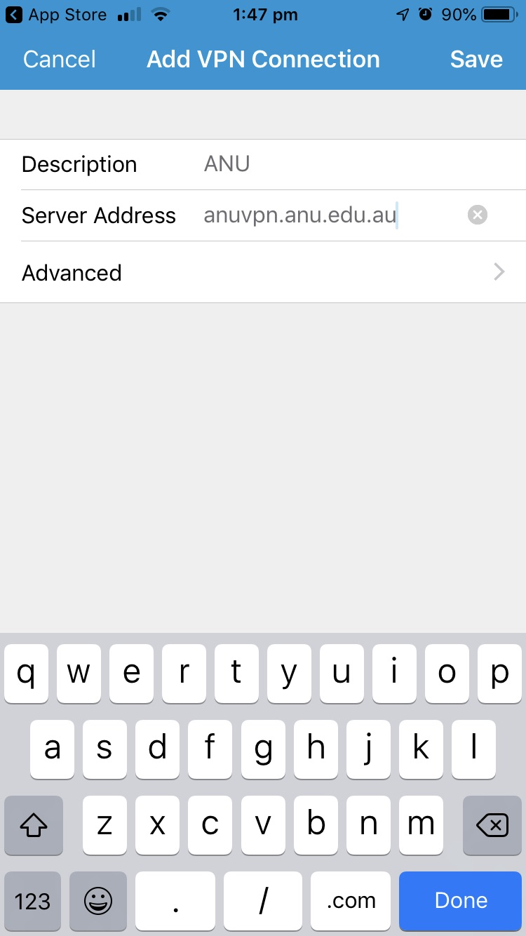
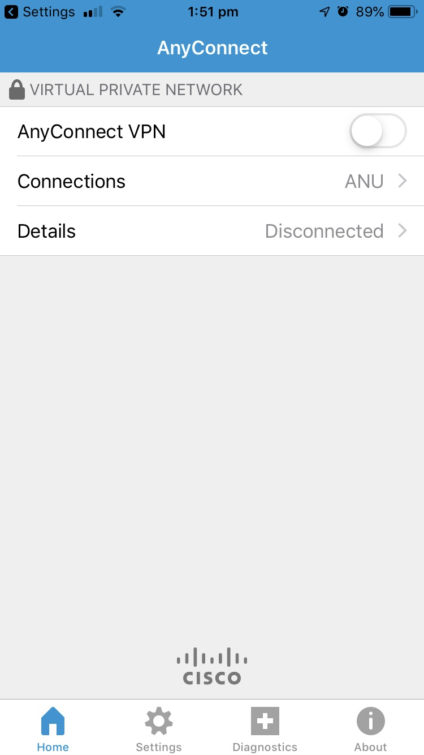
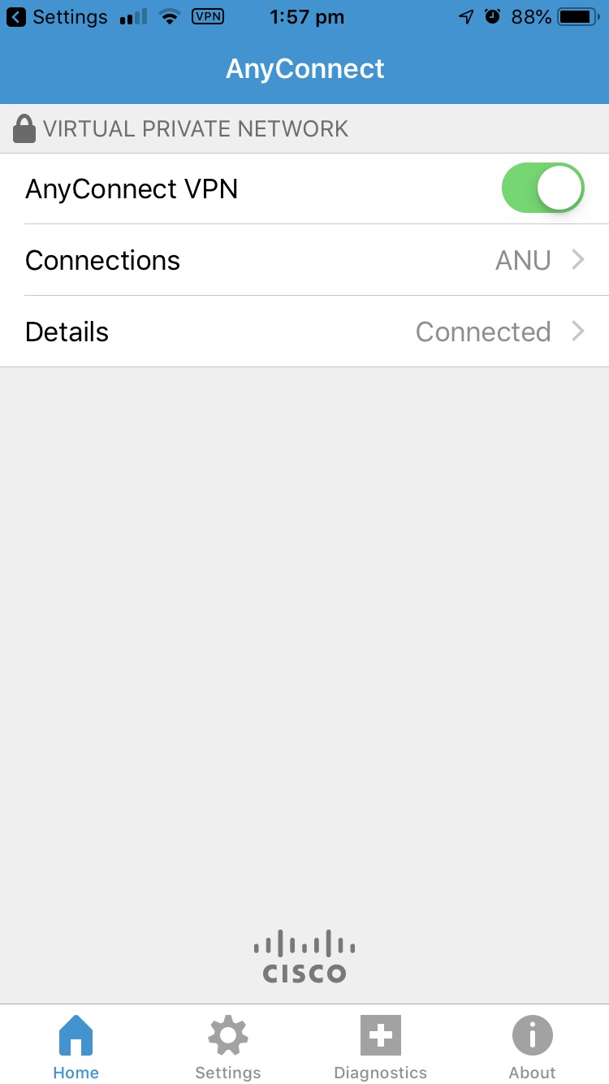
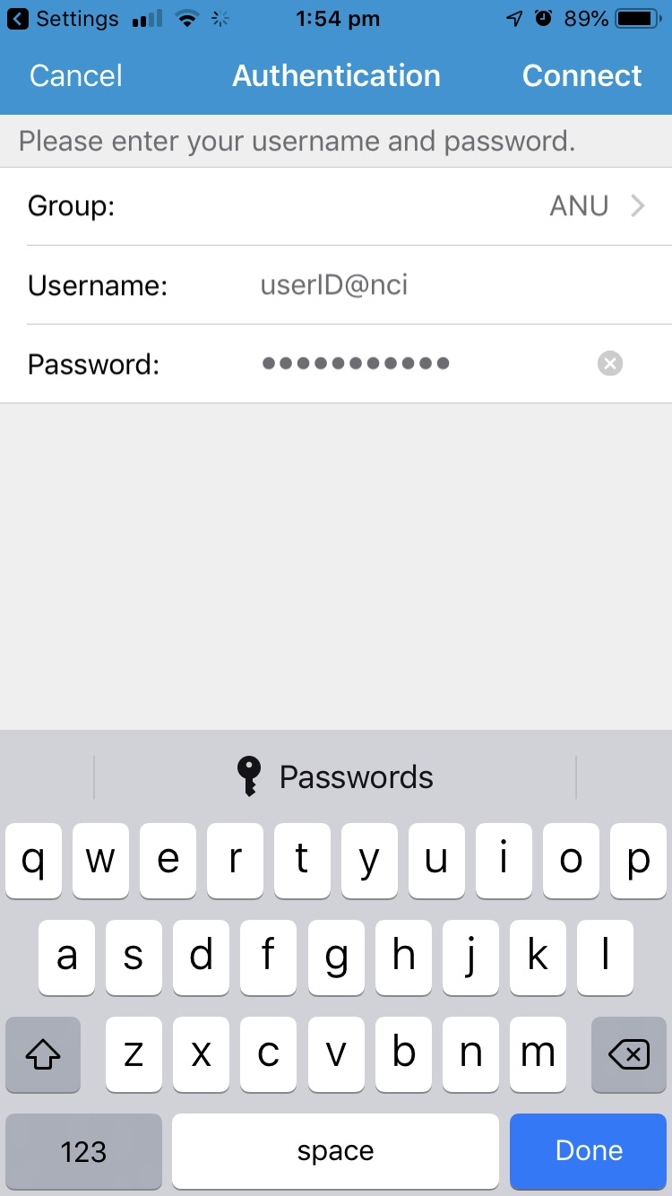
User Guide
Google Earth Mobile - Setup VPN
This section describes the use of GskyGE on mobiles. Firstly, the VPN and Google Earth Apps must be installed.
Next: Google Earth Mobile (Contd.)

Slide 12
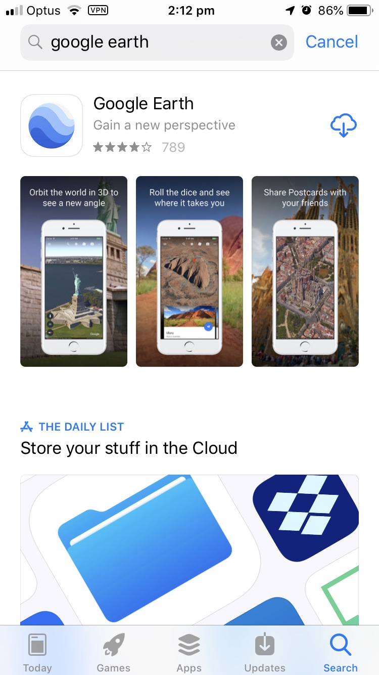
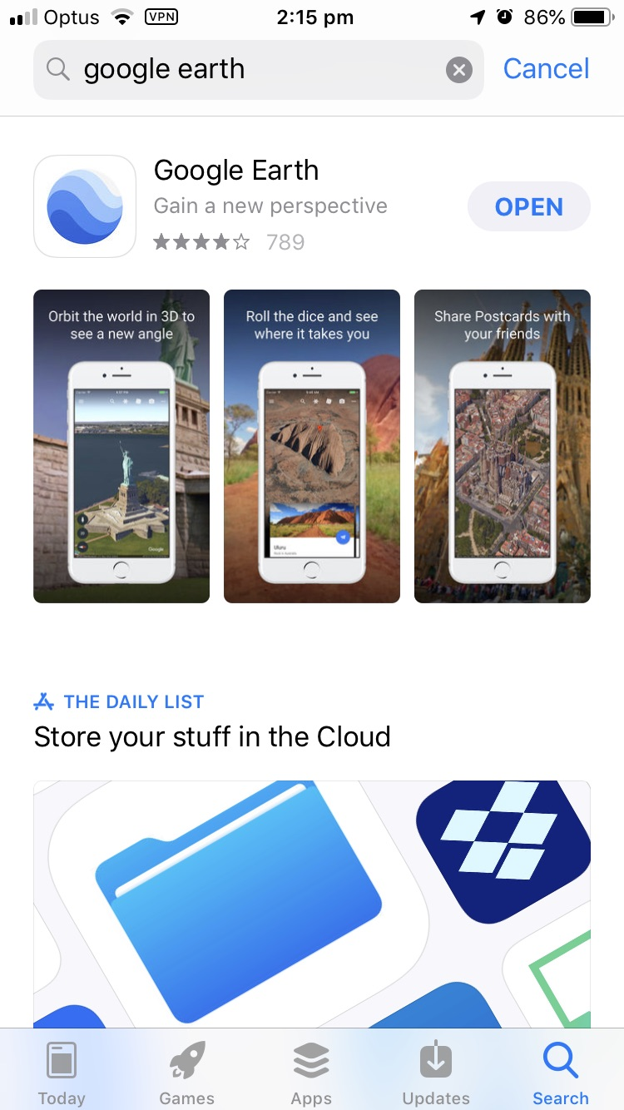
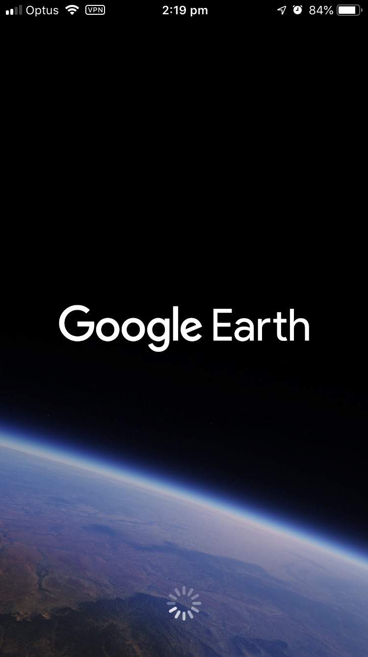
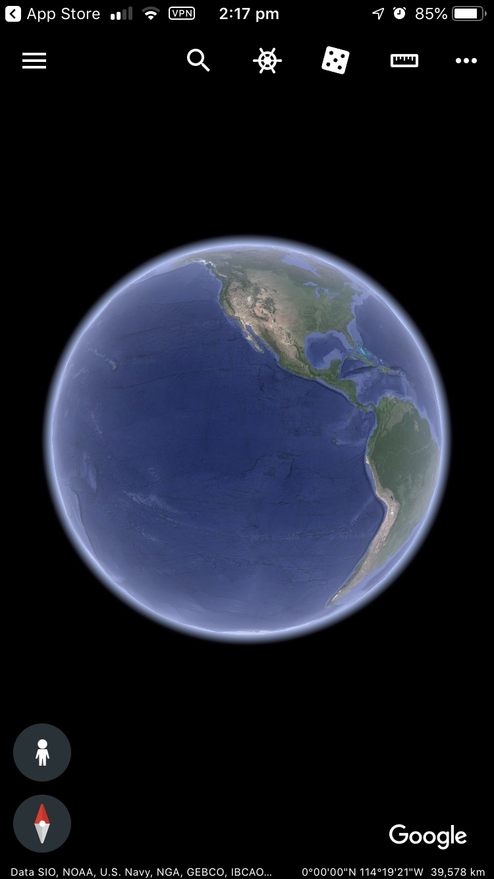
User Guide
Setup Google Earth App
Next: GskyGE on Google Earth Mobile

Slide 13
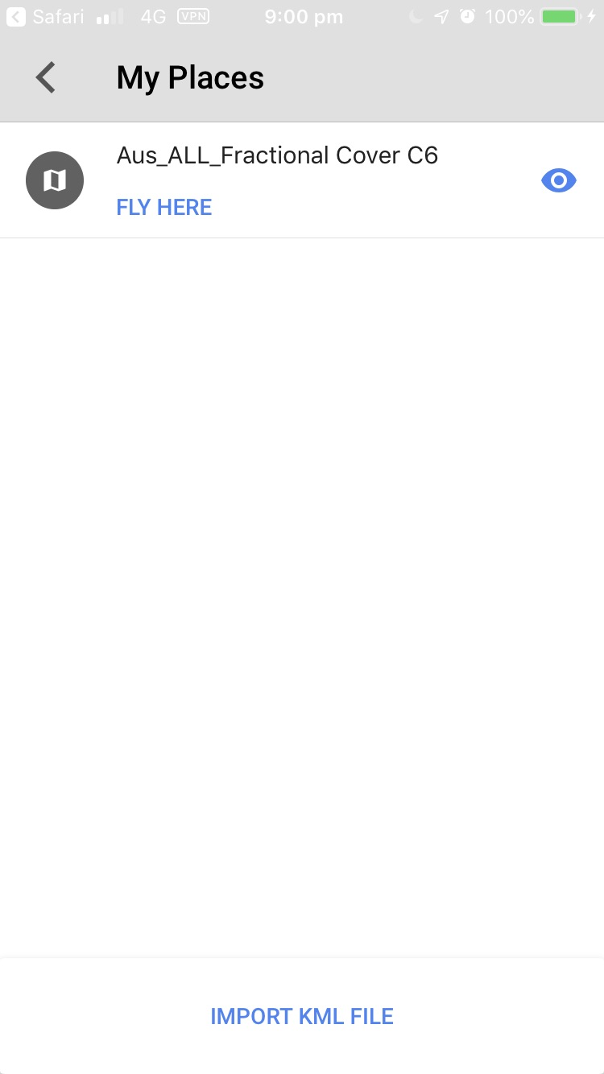
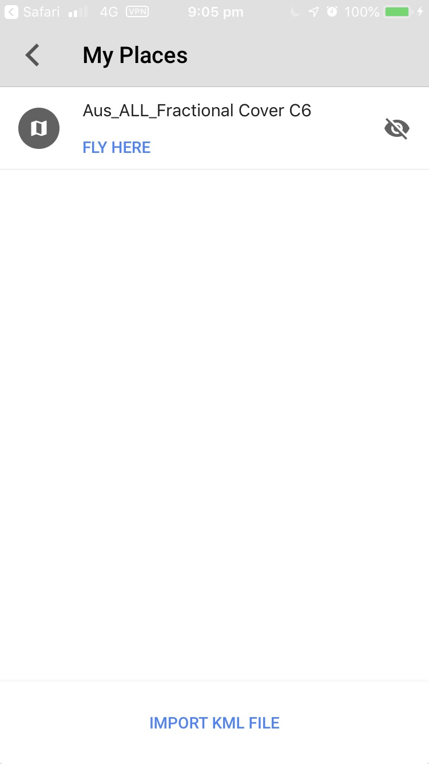
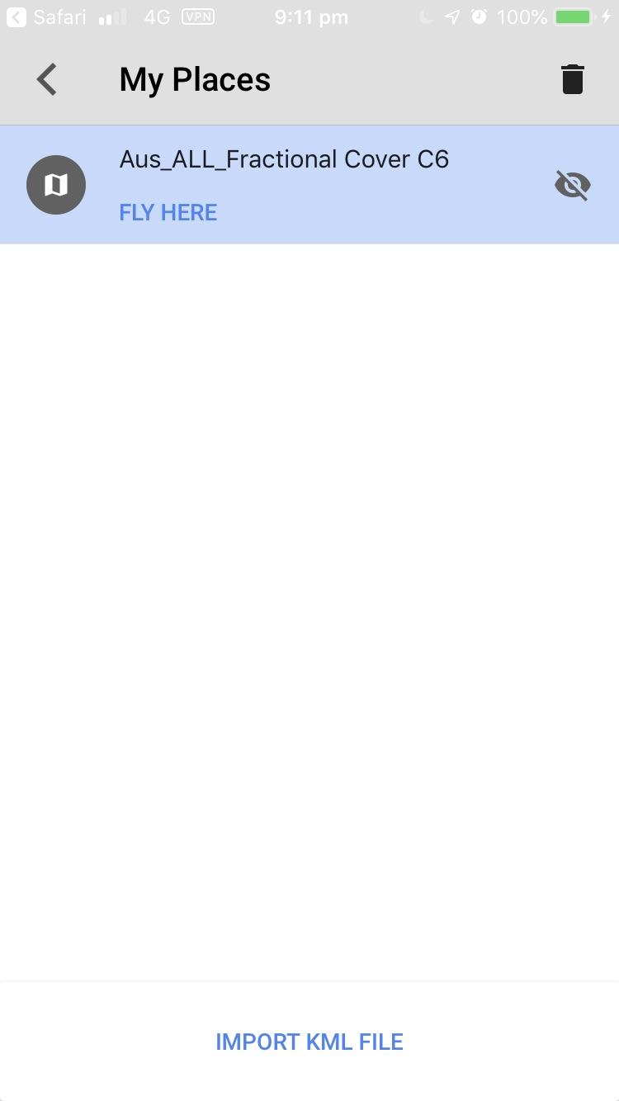
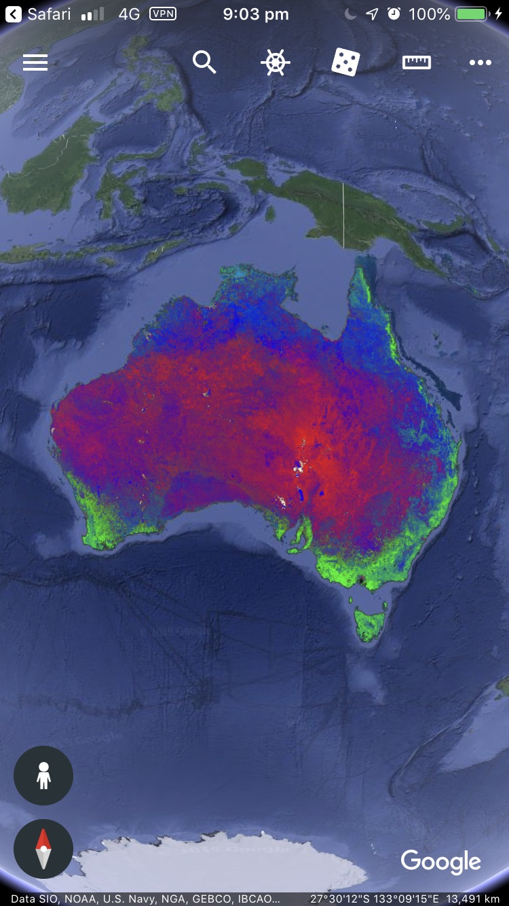
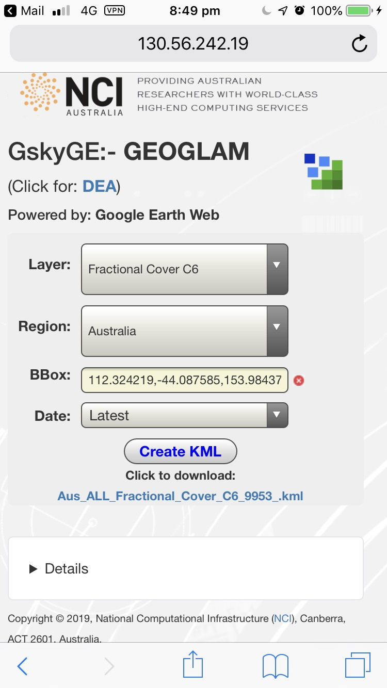
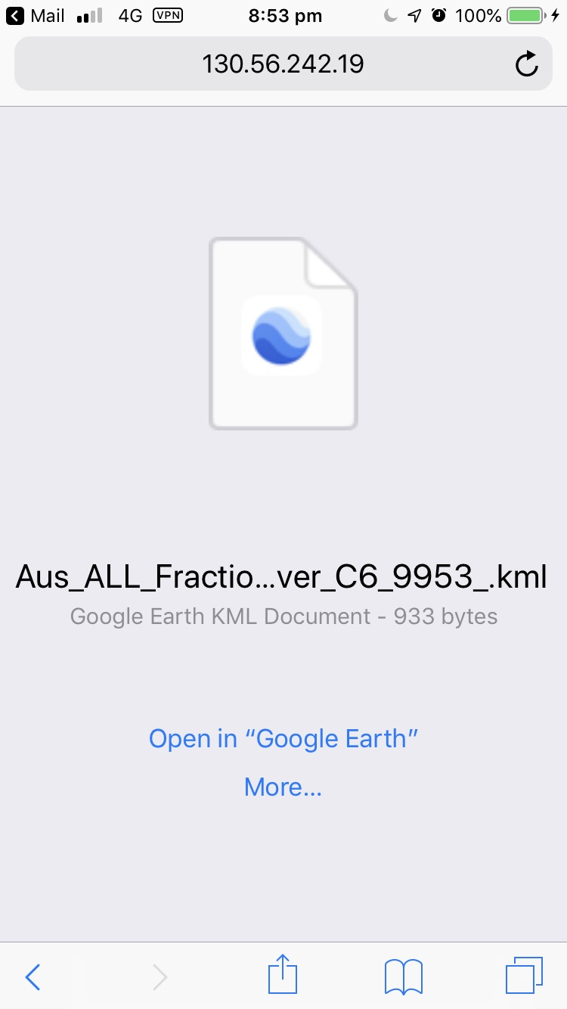
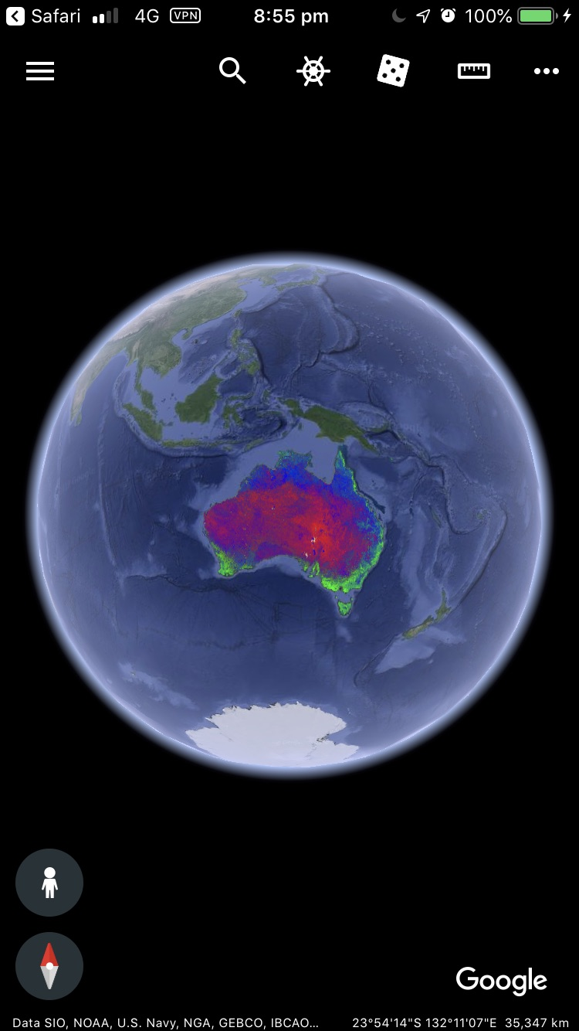


User Guide
GskyGE on Google Earth Mobile
This section describes the use of GskyGE on mobiles.
Next: End of Slides

Slide 14






Acknowledgements

